Slide 1

Wireless Networking
Ambuj Varshney
Assistant Professor, National University of Singapore
Wireless, Embedded Intelligence, Sensing, and Emerging Technologies Group
ambujv@nus.edu.sg

Slide 2
Administration and Course Logistics

Slide 3
Assignment 2
Link: https://weiserlab.github.io/ambuj/cs4222_assignment2
Deadline (EXTENDED): 10th of March 2023
Covers: 7% of overall grade
Program Sensor Tag, Implement State Machine, Using Actuators and Sensors
No Plagiarism! We will check for code similarity
No ChatGPT for this assignment
Submission: We will open link on Canvas
Notes:
++ We may all have heard of the term Internet of Things. So how are these wireless embedded systems related to the Internet of Things: Today, IoT includes a broad class of devices, including powerful platforms such as smartphones. However, it also includes more resource-constrained devices and what we call Wireless Embedded Systems, and in fact, I consider it to be one of the essential parts of the IoT ecosystem.
++ These are platforms equipped with a radio transceiver, sensor, microcontroller, and some form of energy storage. These platforms also often form a network, and sensor network as it is called has been an active area of research for the past two decades.
++ The research community has also developed wireless embedded platforms which we may know about, and these include: CMUCAM, which is an image sensor platform developed at Carnegie Mellon University, or Permamote is long life sensor platform from the lab I am associated with at UC Berkeley or Lorea which is a long-range backscatter platform that I had developed as part of my doctoral dissertation at Uppsala University. All of these are an example of Wireless Embedded Systems.

Slide 4
Tutorial
This week: Localisation and MAC
Next tutorial: Uploaded tomorrow!
Notes:
++ We may all have heard of the term Internet of Things. So how are these wireless embedded systems related to the Internet of Things: Today, IoT includes a broad class of devices, including powerful platforms such as smartphones. However, it also includes more resource-constrained devices and what we call Wireless Embedded Systems, and in fact, I consider it to be one of the essential parts of the IoT ecosystem.
++ These are platforms equipped with a radio transceiver, sensor, microcontroller, and some form of energy storage. These platforms also often form a network, and sensor network as it is called has been an active area of research for the past two decades.
++ The research community has also developed wireless embedded platforms which we may know about, and these include: CMUCAM, which is an image sensor platform developed at Carnegie Mellon University, or Permamote is long life sensor platform from the lab I am associated with at UC Berkeley or Lorea which is a long-range backscatter platform that I had developed as part of my doctoral dissertation at Uppsala University. All of these are an example of Wireless Embedded Systems.

Slide 5
Learning Objective for Today’s Lecture
Review: last few lecture’s topics
Basics of Medium Access Control
Classical/Historical Medium Access Control for IoT
Multi-channel MAC
IEEE 802.15.4
WiFi Mac

Slide 6
Review of Last Lecture

Slide 7
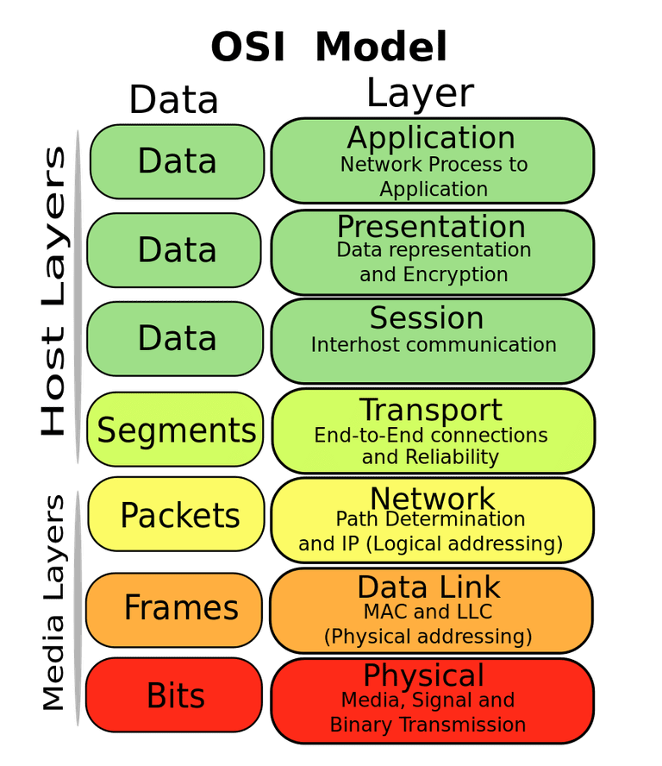
OSI model of communication layers
Transport
How to form connections between computers
TCP and UDP
Network
How to send packets between networks
IP
CS domain: CS340
Data Link
How to send frames of data
Ethernet, WiFi
Our focus
Physical
How to send individual bits
Ethernet, WiFi

Slide 8
Protocols are “layered”
Headers for each layer of communication wrap data
Data is wrapped with header for the network to make a packet
Packet is wrapped with header for the link to make a frame
Internet Packet
Data
Packet Header
Frame Header
Ethernet Frame

Slide 9
Data Link Layer
Framing
Combine arbitrary bits into a “packet” of data
Logical link control
Manage transfer between transmitter and receiver
Error detection and correction
Media access
Controlling which device gets to transmit next
Inherently coupled to PHY and its decisions

Slide 10
Framing
Typical packet structure
Preamble - Existence of packet and synchronization of clocks
Header - Addresses, Type, Length
Data - Payload plus higher layer headers (e.g. IP packet)
Trailer - Padding, CRC
Wireless considerations
Control information for Physical Layer
Ensure robustness for header
Explicit multi-hop routing
Possibly different data rates for different parts of packet
Preamble | Destination Address | Source Address | Type and Length | Data | CRC

Slide 11
Error control: detection and recovery
Detection: only detect errors
Make sure corrupted packets get discarded
Cyclical Redundancy Checks
Detect single bit errors
Detect “burst” errors of several contiguous bits
Recovery: also try to recover from small bit errors
Forward error correction
Retransmissions
Far more important for wireless because the cost of transmission is higher

Slide 12
Wireless is a shared medium
Wired communication has signals confined to a conductor
Copper or fiber
Guides energy to destination
Protects signal from interference
Wireless communication is inherently broadcast in nature
Energy is distributed in space
Signals must compete with other signals in same frequency band

Slide 13
Analogy: wireless medium as acoustic
How do we determine who gets to speak?
Two simultaneous speakers also lose both “transmissions”
Eye contact (or raise hand) -> out-of-band communication
Wait until it’s quiet for some time -> carrier sense multiple access
Strict turn order -> time division multiple access
Just speak and hope it works -> ALOHA
Everybody sing at different tones -> frequency division multiple access (stretching the metaphor)

Slide 14
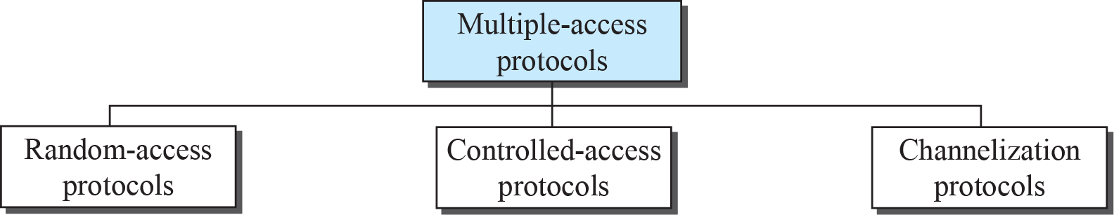
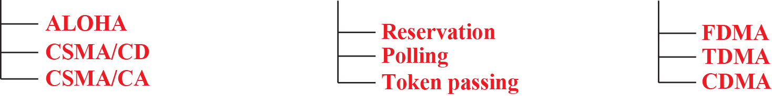
Review: Taxonomy of multiple-access protocols
Reduce collision,
“manage” retransmission
Avoid collision

Slide 15
Random access medium access control protocols
No coordination
The simplest: ALOHA
When a node needs to send, it does so.
If it hears an acknowledgment within a given duration, transmission is successful
otherwise, it resends after waiting a random amount of time.
Protocol strength
minimum overhear
achieves low delay if the load is light

Slide 16
ALOHA
ALOHAnet (1971)
University of Hawaii – Norman Abramson
First demonstration of wireless packet network
Rules
If you have data to send, send it
Two (or more) simultaneous transmissions will collide and be lost
Wait a duration of time for an acknowledgement
If transmission was lost, try sending again “later”
Want some kind of exponential backoff scheme here

Slide 17
Slotted ALOHA
Split time into synchronized “slots”
Any device can transmit whenever it has data
But it must transmit at the start of a slot
And its transmission cannot be longer than a slot
Removes half of the possibilities for collisions!
At the cost of some synchronization method
time

Slide 18
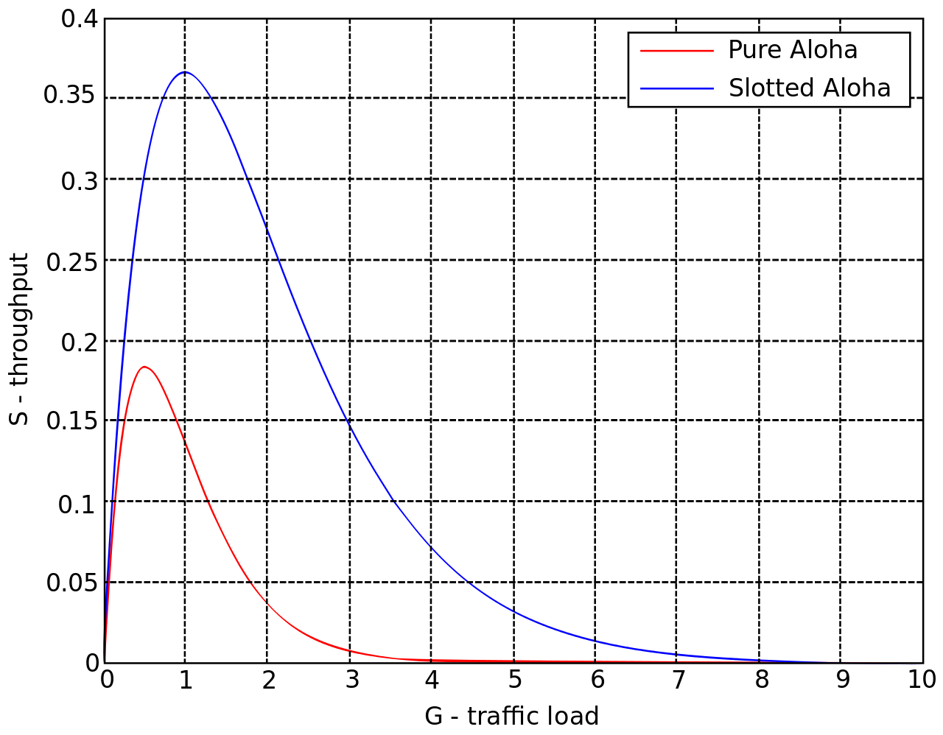
ALOHA throughput
It can be shown that traffic maxes out at
ALOHA: 18.4%
Slotted ALOHA: 36.8%
Assuming Poisson distribution of transmission attempts
Slotted throughput is double because the “before” collisions can no longer occur

Slide 19
Carrier Sense Multiple Access
Carrier Sense Multiple Access:
sense carrier
If idle,
send
wait for ack
If there isn’t one, assume there was a collision, retransmit
Should we transmit immediately once channel is idle?

Slide 20
CSMA/CD – CSMA with Collision Detection
Detect collisions during your own transmission
Works great on wired mediums (Ethernet, I2C)
Somewhere between challenging and impossible for wireless
Transmit and receive are usually the same antenna
Receiving while transmitting would be drowned out by transmission
Remember: TX at 8 dBm and RX at -95 dBm

Slide 21
Carrier Sense Multiple Access/ Collision Avoidance
CA – Collision Avoidance
if the channel is clear, deferred transmission for a "random" interval
Choose interval from a uniform distribution with values between 0 and maximum window size W_{max}
reduces the probability of collisions on the channel
How large should W_{max} be?
If interval is long, time is “wasted” …
If interval is too short?

Slide 22
Hidden terminal problem
Device C
Device A
Device B

Slide 23
CSMA with RTS/CTS
Hidden terminal problem means that two transmitters might never be able to detect each other’s transmissions
A partial solution
When channel is idle, transmitter sends a short Request To Send (RTS)
Receiver will send a Clear To Send (CTS) to only one node at a time
RTS collisions are faster and less wasteful than hidden terminal collisions
Downside: overhead is high for waiting for CTS when contention is low

Slide 24
Solving Hidden Terminal Problem
Should RTS/CTS be used all the time?
B
RTS
CTS
CTS
A
C
OK, I’ll wait …

Slide 25
Review: Taxonomy of multiple-access protocols
In controlled access, the stations consult one another to find which station has the right to send. A station cannot send unless it has been authorized by other stations.

Slide 26
Medium access control: Controlled Access
How do you control who has access to medium?
Reservation
Polling
Token Passing

Slide 27
Taxonomy of multiple-access protocols
“static” allocation of resources

Slide 28
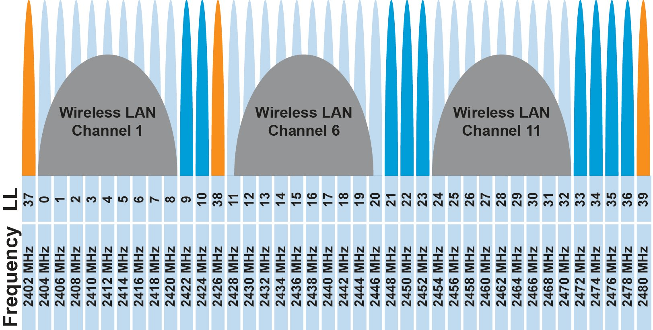
FDMA – Frequency Division Multiple Access
Split transmissions in frequency
Different carrier frequencies are independent
Fundamentally how RF spectrum is split
Technically, each device uses a separate, fixed frequency
Walkie-talkies
Conceptually, how RF channels work
WiFi networks pick different bands
802.15.4 picks a channel to communicate on

Slide 29
TDMA – Time Division Multiple Access
Split transmissions in time
Devices share the same channel
Splits time into fixed-length windows
Each device is assigned one or more windows
Can build a priority system here with uneven split among devices
Requires synchronization between devices
Often devices must listen periodically to resynchronize
Less efficient use of slots reduce synchronization
Large guard windows. E.g. 1.5 second slot for a 1 second transmission

Slide 30
TDMA: Time Division Multiple Access‏
Consider a 1Mbps channel (1,000,000bits/sec)
Divide channel into 1000 (equal) times slots
Each slot is 1ms, and can transmit 1,000 bits
Assign slots to 50 users
Each user transmits every 50 slots/ms and transmit 20 times/slots per second
On average, each user can transmit 20kbps
Buffering is needed on both sender and receiver to match the differences in data rates
sender-side: 20kbps -> 1 Mbps
Receiver-side: 1Mbps -> 20kbps
Notes:
30
30

Slide 31
TDMA vs. FDMA
FDMA
TDMA
Frequency
Frequency
Time
Time
In practical systems, TDMA is often combined with FDMA
Frequency
Time
Notes:
31
31

Slide 32
Orthogonal Frequency Division Multiplexing :OFDM
In FDM, the entire frequency spectrum is dedicated to carry data from a single source
Example: transmit at 40Mbps over a 20 MHz spectrum
In OFDM, data is divided into many (slower) bit streams and multiple subcarriers (each with smaller spectrum) is used
Example: divide data source into 40 sources, each 1Mbps

Slide 33
Spread Spectrum (SS)
Spread-spectrum techniques are methods by which a signal is deliberately spread in the frequency domain, resulting in a signal with a wider bandwidth
Such techniques can be used to establish secure communications, increase resistance to natural interference, jamming and to prevent detection
Concept has been alluded to in 1900s, and applied in some form during WWII

Slide 34
Spectrum of Combined Signal
Resistant to narrowband interference
Signals are difficult to interpret – appears as if increase in background noise
Can share frequency band with others with minimal interference

Slide 35
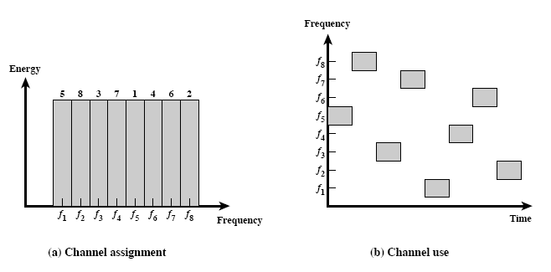
Frequency Hopping (FH)
How does FHSS increase resistance to
natural interference
jamming
detection

Slide 36
Real-world protocol access control
ALOHA
BLE advertisements
Unlicensed LPWANs: Sigfox, LoRaWAN
CSMA
WiFi (slotted, CSMA/CA)
TDMA
BLE connections
Cellular LPWANs: LTE-M and NB-IoT

Slide 37
Learning Objective for Today’s Lecture
Review: last few lecture’s topics
Basics of Medium Access Control
Classical/Historical Medium Access Control for IoT
Multi-channel MAC
IEEE 802.15.4
WiFi Mac

Slide 38
Basics of Medium Access Control for Internet of Things

Slide 39
Medium access control for Internet of Things
For traditional MAC, want
Low Latency
High Utilization
Fair
How about (Internet of Things or energy efficient) MAC?
Power Consumption is a key consideration.
(Most) sensor applications have low channel utilization
If energy consumption is the main concern, how would you design the MAC protocol differently?

Slide 40
Energy consumption of medium access control
The main sources of energy consumption in any contention-based MAC protocol:
overhearing
control packet overhead
data transmission/reception
idle listening
(1) – (3) occurs only when there is a transmission
(4) occurs even when there is no traffic

Slide 41
“Life Cycle” of MAC Protocols
(4)
(1) – (3)
(4)
(1) – (3)
(4)
(1) – (3)
Less Traffic
(4)
(1 – (3)
(4)
(1) – (3)
Less Traffic
(4)
(4)

Slide 42
Idle listening is energy expensive
Idle listening consumes most of the energy as traffic load decreases
Many measurements have shown that idle listening consumes 50–100% of the energy required for receiving
But if you do not listen to the channel, how do detect events/transmissions?

Slide 43
Duty cycled medium access control protocols
Overhearing or passive listening is very expensive, in particular, if utilization is low
Proposal: Don’t overhear, go to sleep!
Advantage:
Consume very little energy when radio is idle/inactive
Problem:
When to wakeup?
Requirements:
Wakeup schedule must be coordinated
The “right” nodes must wake up at the “right” time

Slide 44
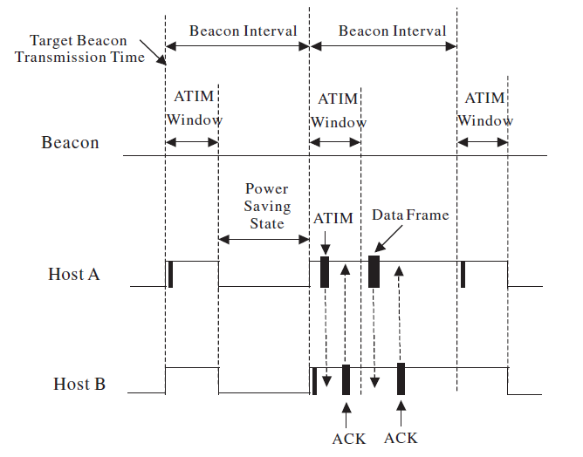
Various power saving modes in WiFi

Slide 45
Various power saving modes in WiFi
Requirements:
AP is always “on”
All other nodes within range of AP
OR
Time synchronization
But what if all nodes are battery powered?

Slide 46
Let's consider Aloha protocol
Consider the simplest MAC protocol – ALOHA
No change to the protocol: when a node wants to transmit, it does
Does it work?
Works when
There is no contention (usually true when utilization is low)
The receiver is listening (may not be true with duty cycle)
How to convert ALOHA to work with duty cycle?

Slide 47
Aloha with Preamble Sampling
Sensing
Sensing
Sensing
Sensing
Receiver
Sender
Preamble
Data
Sensing
Sensing
Sensing
Recv
ACK
Receiver 1
Sensing
Sensing
Receiver 2
(Possible we can miss the preamble and thus data?)

Slide 48
Aloha with Preamble Sampling
Tp
Sender
Preamble
Data
Sensing
Sensing
Sensing
Recv
ACK
Receiver 1
Ts
T_{D}
Each receiver periodically (every Tp) wakes up to check if the channel is busy for a duration of (Ts)
If channel is busy, stays in listening mode until destination of data is known (transmitted), else go back to sleep for a period of (Tp-Ts)
Sender transmits a long preamble (Tp), and then send data packet at the end of the preamble period of packet transmission
Is this protocol energy efficient?

Slide 49
Examples
Parameters:
TP = preamble length
TS = preamble sample length
TD = (data + ack) length
No traffic:
Duty cycle = TS/TP
Always backlog:
utilization < (TD) / (TD + TP)

Slide 50
Example (cont’d)
Very low channel utilization, say x%
1 transmitter and N receivers
Assume transmission and reception energy are the same, so we can only consider {send, receive, listen} duration
When there is transmission
Transmitter’s energy consumption = (TP+TD)
Receivers’ energy consumption = N(0.5TP) + TD
When there is no transmission
All are “receivers”, energy = TS
For very small x, total energy ~ (N+1)TS
Duty cycle is low if (TS/TP) is low

Slide 51
Example (cont’d)
Price is latency and maximum utilization
Latency to send a packet is (TP+TD)
Maximum utilization is TD/(TP+TD)
Need to balance the conflict among
Reducing energy consumption
Providing sufficient throughput
Lowering end-to-end delay

Slide 52
Classical/Historical Medium Access Control for Internet of Things

Slide 53
B-MAC: Medium Access Control
B-MAC is an asynchronous MAC protocol based on preamble sampling. It is one of the earliest medium access control protocol for internet of things
A node turns on its radio periodically to check for activity. If it receives a packet, it stays awake. Otherwise, it goes back to sleep after a timeout
To ensure successful reception, the preamble length must be equal to or much longer than the channel sampling interval
Idle listening occurs when the node samples the channel and finds no activity
For reliable reception, preamble length (Tp) is matched to the interval that the channel is checked for activity
If the channel is checked every 100ms, preamble must be at least 100ms long
Idle listening occurs when the node wakes up to sample the channel

Slide 54
Power Profile of B-MAC

Slide 55
Improving B-MAC
While the design of B-MAC makes suitable for low power/low duty operations, its performance can be improved
Transmitter:
Is a long (continuous) preamble necessary?
(Potential) Receivers:
Is a long (average) waiting period necessary?

Slide 56
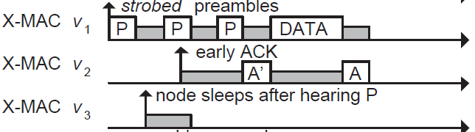
Improving B-MAC with X-MAC
X-MAC improves over B-MAC
Sender transmits many “probes” with gaps between probes. Each probe contains address of intended receiver
Receiver checks address embedded in probe, sends acks if it is the destination during the gap period between probes
Sender transmits DATA, receive replies with Ack to complete data transfer

Slide 57
ContikiMAC
ContikiMAC is the MAC protocol implemented in Contiki OS

Slide 58
t_{s} the time to transmit a packet

Slide 59
Example of timing in Contiki MAC
t_{r} is given by the data sheet of the CC2420 radio transceiver as 0.192 milliseconds.
t_{i} = 0.4 milliseconds
t_{c} = 0.5 milliseconds
Minimum t_{s} = 0.884 milliseconds
> 0.4 + 2*(0.192)
Determines the smallest packet size
With a bitrate of 250kbps, and a 7 byte overhead per packet, minimum packet size using Contiki MAC is 21 bytes

Slide 60
Receiver wakeup frequency is lower, e.g. 8Hz

Slide 62
Receiver-Based Preamble Sampling
In B-MAC, X-MAC and Contiki MAC, sender transmits long preamble
Can we switch from sender-initiated to receiver-initiated?
Is there any advantage?

Slide 63
Receiver Initiated MAC (RI-MAC)
Change to receiver based (RI-MAC)
Transmitter wakes up and listens for a period of TP
Receiver wakeups up every TP and sends a small packet to announce its presence
Transmitter initiates transmission if the “right” receiver wakes up
Advantage
Less transmission and hence less collision
May consume less energy

Slide 64
Receiver Initiated MAC (RI-MAC)

Slide 65
Lifetime calculation of B-MAC
Consider a node running B-MAC. It wakes up periodically every 200ms to sample the channel for 2ms. If there is no channel activity, it goes back to sleep. The transmission and reception/listening states draw 10mA
The sleeping state draws 0.1mA. If there is no transmission, what is the average current consumption of a node?
Average = 0.99 x 0.1 + 0.01 x 10 = 0.099 + 0.1 = 0.199mA
Consider a scenario with sensor node A transmitting a very small packet to node B every 2s and both nodes use B-MAC. Calculate the average current consumption of nodes A and B
Node A: 0.1 (10) + 0.9 * 0.199 = 1 + 0.1791 = 1.1791mA
Node B: 0.1 (5.05) + 0.9 * 0.199 = 0.505 + 0.1791 = 0.6841mA

Slide 66
Synchronous MAC
Why not let all nodes wakeup at the same time?
SMAC’s solution
Some form of time division multiplexing
Divide interval into listening and sleeping
Percentage of listening period is the “duty cycle”

Slide 67
Synchronous MAC (SMAC)
Example: 10% duty cycle
Each node listens for 100ms and sleep for 0.9s
Each node listens for 1s and sleeps for 9s

Slide 68
S-MAC

Slide 69
S-MAC: Challenges
Problem: How to synchronize the schedule of all nodes?
Initially, nodes are deployed to start after a random time interval
The node whose timer expires first is the synchronizer
Boundary nodes adopt multiple schedules

Slide 70
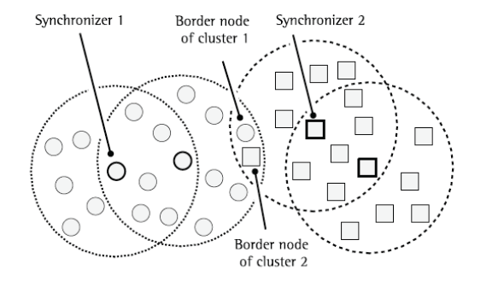
SMAC Schedule Coordination

Slide 71
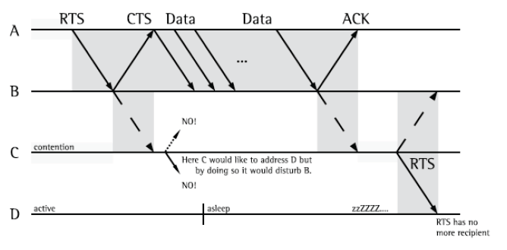
Issue with RTS/CTS (with duty cycle)
Does problem exist if D only sleeps when channel is idle?

Slide 72
Multi-Channel MAC

Slide 73
Wireless communication over multiple channels
Why do we need multiple channel for wireless communication?
Increase throughput
spatial diversity
Increase reliability

Slide 74
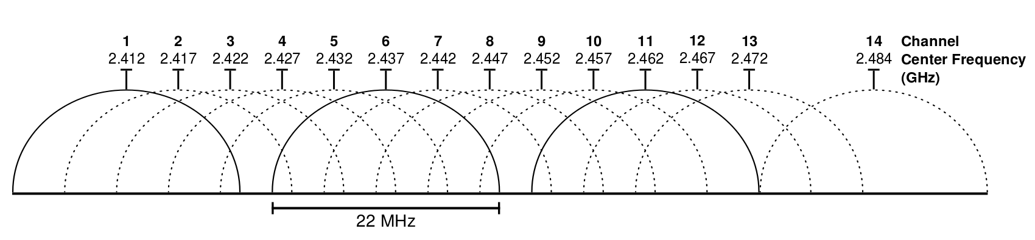
Wifi Channels
14 channels designated in the 2.4 GHz range spaced 5 MHz apart (with the exception of a 12 MHz spacing before channel 14)
https://en.wikipedia.org/wiki/List_of_WLAN_channels

Slide 75
ZigBee Channels

Slide 76
WiFi Channel Usage

Slide 77
Cross Channel Interference (CTI)
A. Hithnawi, et.al.,TIIM: Technology-Independent Interference Mitigation for Low-power Wireless Networks, IPSN 2015

Slide 78
CTI (cont’d)

Slide 79
Multi Channel MAC Protocols
Use a control channel:
Use of a default channel and time synchronization for control message exchange
Nodes switch to a different channel for data communication
All channels are used for data communication:
Nodes switches to another channel when link quality is bad
How do we find a “good” channel to switch to?

Slide 80
TSCH Network
Time is divided into slots, multiple slots form a slotframe
Sends to receiver on slots it is listening on (e.g. green to C, red to A)
Frequency chosen for a timeslot is based on a pseudo-random pattern
Scheduling policy is not standardized

Slide 81
IEEE 802.15.4: ZigBee

Slide 82
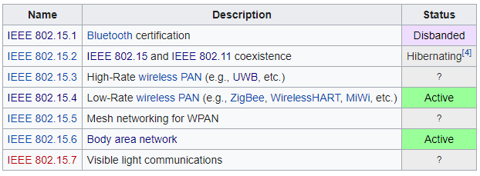
IEEE 802.15
Wireless Personal-Area Networks (WPAN)
All the things within the workspace of a person
Conceptually smaller domain that the Local Area Network
Realistically about the same thing as a LAN
Formerly included a Bluetooth spec
Bluetooth SIG took over governance

Slide 83
802.15.4 Overview
Goals
Explicit support for low-cost, low-power, low-throughput devices
Focus on low complexity for specification
Only PHY and MAC are part of specification
Target home automation
Secondarily industrial control/monitoring, vehicular sensing, and agricultural uses

Slide 84
IEEE 802.15.4
Low-Rate Wireless PAN
250 kbps, ~100 m range
Radio hardware available with low-power and low-cost
Specification: 2003
Also 2006, 2011, 2015, and 2020 revisions
Mostly various added capabilities such as extra PHY layers
Also define optional security, scheduling, and larger frame sizes
We’ll mostly work off of the 2006 version
Thread is based on 2006 version
Zigbee is based on the original 2003 version
Roughly 200 pages of meaningful specification (100 of appendices)
Compare to 3000 pages of Bluetooth/BLE

Slide 85
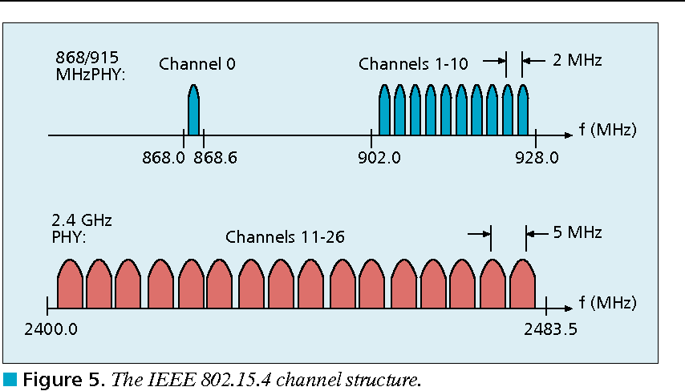
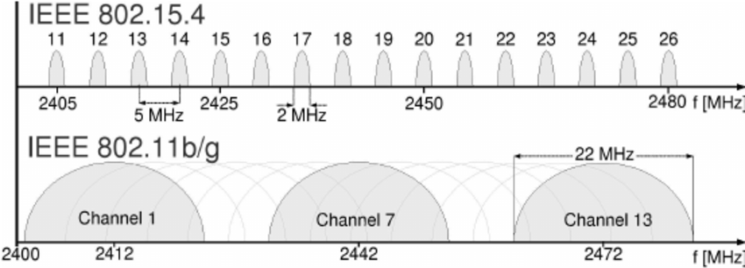
802.15.4 RF channels
27 channels across three bands
5 MHz channel separation at 2.4 GHz
Compare to 2 MHz for BLE

Slide 86
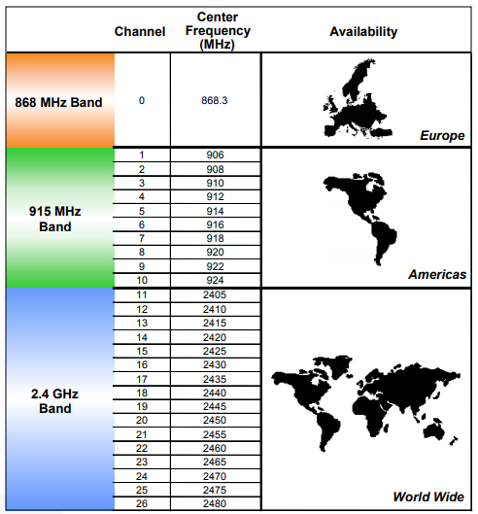
Regional bands
Different RF bands have different regional availability
Also have different rules
915 MHz: 400 ms dwell time
868 MHz: 1% duty cycle

Slide 87
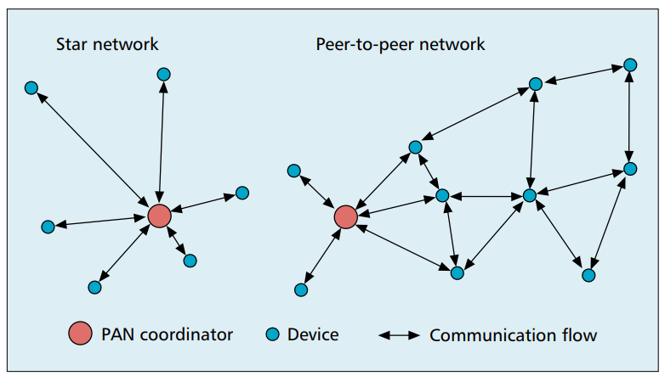
802.15.4 network topologies
Only specifies PHY and MAC, but has use cases in mind

Slide 88
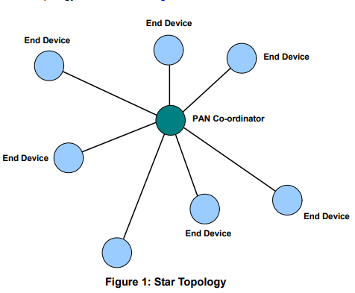
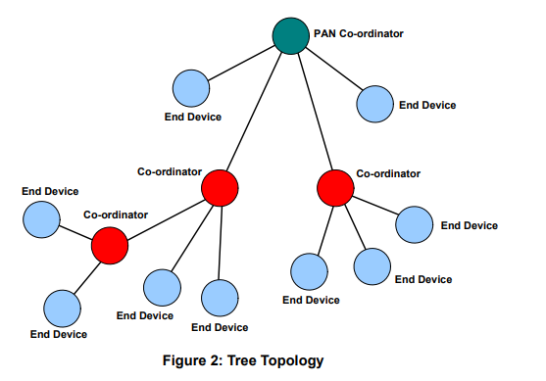
Star and Tree topologies
PAN Coordinator
Receives and relays all messages
Most capable and power-intensive
Coordinators (a.k.a. Routers)
Control “clusters”
Receives and relays to its children
Communicates up to parent coordinator
End Devices
Only communicate with single parent coordinator
Least capable and power intensive

Slide 89
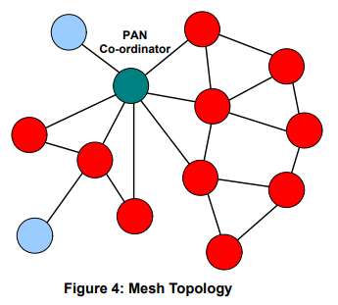
Mesh networks
Most devices are capable of communicating with multiple neighbors
What are advantages of mesh?
What are disadvantages of mesh?

Slide 90
Mesh networks
Most devices are capable of communicating with multiple neighbors
What are advantages of mesh?
Devices can communicate over longer distances
Device failures less likely to collapse the entire network
What are disadvantages of mesh?
Some nodes have to spend more energy communicating
Network protocol becomes more complicated to manage routing

Slide 91
Modes of operation
Beacon-enabled PAN
Slotted CSMA/CA
Structured communication patterns
Optionally with some TDMA scheduled slots
Non-beacon-enabled PAN
Unslotted CSMA/CA
No particular structure for communication
Could be defined by other specifications, like Thread or Zigbee

Slide 92
Beacon-enabled superframe structure
Beacon
Beacon
…
Contention Access Period
Inactive Period
Beacons occur periodically [15 ms – 245 seconds]
Devices must listen to each beacon
Contention Access Period
Slotted CSMA/CA synchronized by beacon start time
Inactive Period
No communication occurring. Assumes sleepy devices

Slide 93
Guaranteed Time Slots (GTS)
Beacon
Beacon
…
Contention Access Period
Guaranteed Time Slots
Inactive Period
PAN Coordinator creates a Contention Free Period with Guaranteed Time Slots
TDMA schedule assigned to specific devices
Slots eat up part of the Contention Access Period
No CSMA/CA within a slot

Slide 94
Non-beacon-enabled PAN
…
Contention Access Period
Same idea, just no beacons
Which removes synchronization benefit (and slotted CSMA/CA)
Also removes beacon listening cost
Devices only need to check for activity before transmitting
Still need an algorithm to determine when it should receive data
All the time is a huge energy drain
Algorithms can get complicated here
Does BLE mechanism of listen-after-send apply?
Only if sending to a high-power device, not among equals

Slide 95
Receiving messages
Listen during entire contention period
Can receive direct messages from any other device
Can immediately respond to messages as well
Request messages from Coordinator
Make all communication go through Coordinator
Send a request-for-data packet to coordinator to get information
Coordinator can include list of devices with pending data in beacon
More complicated listening algorithms are possible

Slide 96
Clear Channel Assessment (CCA)
The “listen” part of CSMA/CA
Variety of implementations are acceptable
Energy above threshold
Energy for 8 symbol durations above threshold (RSSI)
Carrier sense
Valid 802.15.4 carrier signal
Energy AND/OR Carrier

Slide 97
Slotted CSMA/CA operation
Have data to send
Wait for next backoff slot (synchronized from beacon)
Wait for 0-7 backoff slots (slot is 20 symbol durations: 320 us)
Listen for two empty slots
Idle: Transmit
Occupied: wait 0-15 backoff slots and repeat
Next time: 0-31 backoff slots and repeat
Next time: 0-31 backoff slots and repeat (upper limit configurable)
Next time: 0-31 backoff slots and repeat
Next time: 0-31 backoff slots and repeat
Timeout

Slide 98
Unslotted CSMA/CA operation
Have data to send
Wait for next backoff slot (synchronized from beacon)
Wait for 0-7 backoff slots (slot is 20 symbol durations: 320 us)
Listen for two empty slots
Idle: Transmit
Occupied: wait 0-15 backoff slots and repeat
Next time: 0-31 backoff slots and repeat
Next time: 0-31 backoff slots and repeat (upper limit configurable)
Next time: 0-31 backoff slots and repeat
Next time: 0-31 backoff slots and repeat
Timeout

Slide 99
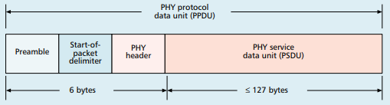
Base packet format
Synchronization
Preamble: four bytes of zeros
Start-of-Packet: 0xA7
PHY Header
One field: length 0-127
Why still 8 bits?

Slide 100
Base packet format
Synchronization
Preamble: four bytes of zeros
Start-of-Packet: 0xA7
PHY Header
One field: length 0-127
Why still 8 bits? Because computers depend on bytes

Slide 101
Analysis: maximum goodput
Assume best possible case for data transmission
122 Bytes per packet
At 250 kbps -> 3.904 ms
Plus Inter-frame spacing of 40 symbols
At 62.5 kBaud -> 0.640 ms
122 Bytes / 4.544 ms -> 214 kbps
Compare to BLE advertisements: 9.92 kbps
Compare to BLE connections: 520 kbps

Slide 102
WiFi: Medium Access Control and Framing

Slide 103
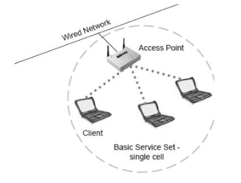
Basic WiFi network
Star topology network
Basic Service Set (BSS)
Access point(s)
Multiple connected clients
Service Set ID (SSID)
Identifies network
Broadcast by access point in beacons

Slide 104
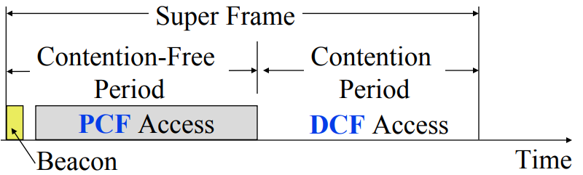
WiFi superframe structure
Beacon followed by contention-free period followed by contention
Repeats periodically (default ~100 ms)
802.15.4 adopted a similar superframe

Slide 105
WiFi superframe in practice
Continuous contention access period
Any device may send at any time
PCF is unused in practice
Periodic beacons
Which also use CSMA and therefore may be delayed
Contention
Based Access
Delayed Beacon
Beacon
Time

Slide 106
802.11 beacons
Transmitted periodically (~100 ms by default)
Enable discovery of network
Contain capabilities and SSID for the network (802.11b/g/n/ac)
Assign contention-free slots if used
Notify devices of waiting packets
Traffic Indication Map (TIM) has a bitmap specifying which devices data is for
Enables devices to sleep, skipping a number of beacons
Handles broadcast/multicast messages
Every N beacons includes a notation of available broadcast messages
Messages are transmitted during next contention access period using normal CSMA
Defines maximum sleep period for devices (must listen to these beacons)

Slide 107
Contention-free access
Known as Point Coordination Function (PCF)
Allocates a contention-free period for specific devices
Access Point decides when to grant based on requests
Drawbacks
Latency depends on beacon intervals
Mechanism for explicit Quality of Service is unclear
PCF is not used in practice

Slide 108
Contention-based access
Known as Distributed Coordination Function (DCF)
Base communication method for WiFi (essentially always)
All packets are immediately ACK’d by receiving device
Uses CSMA/CA to determine when it can send
With random backoff
Problem: packets can be very long (up to 20 milliseconds)
Solution: Network Allocation Vector (NAV)
Packets include a notation of their duration
Sensing the beginning of a packet allows backoff to skip the whole packet duration before continuing

Slide 109
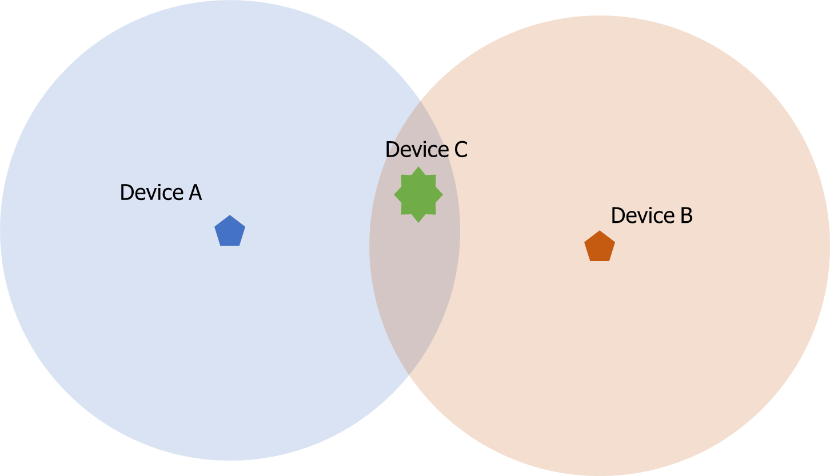
Reminder: hidden terminal problem
Devices communicating with Access Point may not hear each other
CSMA fails and Access Point losses both messages
A solution: RTS/CTS (Request/Clear To Send)

Slide 110
Drawbacks of RTS/CTS
Four packets per data (RTS, CTS, Data, Ack)
Could have just sent data instead of RTS
Significant portion of traffic are application-layer Acks
Probably better to just have it fail and try again later
RTS/CTS only used for very large packets in practice
*It’s mentioned still in 802.11n and 802.11ac, so not entirely unused

Slide 111
Backoff in WiFi
Listen for activity
If free
Wait for Inter Frame Spacing (IFS)
If still free, transmit
If busy
Randomly select a number of backoff Slots
Count down slots whenever medium is not busy
If busy when backoff completes:
Increase maximum backoff Slots
Repeat
Slot time: basic time unit for protocol
Total time of: switch from Rx to Tx, plus processing time, plus propagation delay

Slide 112
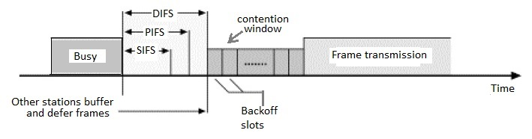
Prioritizing packets with varying IFS
Tiered Contention Multiple Access (TCMA)
Idea: assign different inter-frame spacing based on traffic class
Inherently prioritizes communication
Acknowledgements sent with Short IFS (SIFS)
Will always transmit before new data clears CSMA check
New data sent with DCF IFS (DIFS)

Slide 113
Putting backoff together
Two variables
Contention Window (CW) – maximum backoff amount
Backoff Count (BO) – current remaining backoff
When attempting to send, if busy Backoff selected in [0, CW]
Countdown Backoff slots whenever medium is not busy
At 0, attempt to transmit if not busy
If busy, double Window and select Backoff again
802.11g values:
Slot time= 20 us, CWmin= 15 slots, CWmax= 1023 slots
SIFS= 10 us, DIFS= 50 us

Slide 114
802.11 backoff example
A and B want to send and see the medium is busy
Followed by an Acknowledgement after SIFS
Other Traffic
ACK
SIFS
DIFS
A
Arrival A
B
Arrival B
C

Slide 115
802.11 backoff example
Each chooses a random backoff [0, CW] (we’ll say CW is 32)
Start counting down backoff slots
Other Traffic
ACK
SIFS
DIFS
A
Arrival A
Backoff = 10
B
Arrival B
Backoff = 8
C

Slide 116
802.11 backoff example
C wants to send, waits DIFS, and can send immediately
No other traffic is going on
A and B pause backoff for packet duration
Other Traffic
ACK
C Traffic
SIFS
DIFS
DIFS
A
Arrival A
Backoff = 10
B
Arrival B
Backoff = 8
C
Arrival C

Slide 117
802.11 backoff example
A and B used NAV to pause backoff for entire traffic plus ACK
After DIFS, resume backoff count from its previous value
Other Traffic
ACK
C Traffic
ACK
SIFS
DIFS
DIFS
SIFS
DIFS
A
Arrival A
Backoff = 10
Backoff = 6
B
Arrival B
Backoff = 8
Backoff = 4
C
Arrival C

Slide 118
802.11 backoff example
B reaches zero backoff, finds channel empty, transmits
A pauses its backoff again for duration plus ACK
Other Traffic
ACK
C Traffic
ACK
B Traffic
SIFS
DIFS
DIFS
SIFS
DIFS
A
Arrival A
Backoff = 10
Backoff = 6
B
Arrival B
Backoff = 8
Backoff = 4
C
Arrival C

Slide 119

Frame structure for WiFi packets
Frame control (various bits)
Type of packet (Control, Management, Data)
Subtype (Association, RTS, CTS, Ack, etc.)
Indication of to/from “distribution system” (Internet rather than intranet)
Duration
Specifies on-air time of full packet in microseconds
Note: no actual length field

Slide 120
Sequence control
4-bit fragment number
12-bit sequence number
Quality of Service control
Identifies traffic category
High Throughput Control
Configurations for selecting best data rate
Frame body
Max size depends on PHY
~2000 for lower rates
~8000 for 802.11n
~11000 for 802.11ac
Frame check sequence
32-bit CRC

Slide 121

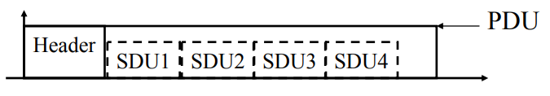
Sending frames in WiFi
Frame bursting
Transmit multiple frames in a row
Frame fragmentation
Split service data over multiple frames
Frame aggregation
Multiple service data in a single frame
Allows multiple packets to reach Access Point in a single transmission

Slide 122
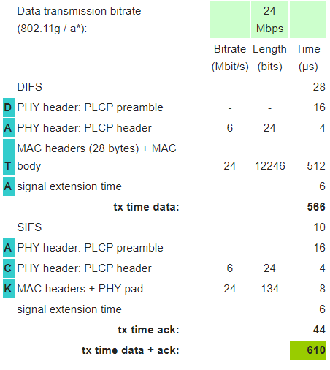
Calculating packet durations
Example duration for a 1500 byte 802.11g packet
6 Mbps for header
24 Mbps for payload
566 μs for total packet
Plus 44 μs for ACK
https://sarwiki.informatik.hu-berlin.de/Packet_transmission_time_in_802.11

Slide 123
802.11e improves MAC layer
Hybrid Coordination Function (HCF)
Modifies contention-free access (still no one uses it)
Modifies contention-based access: Enhanced Distributed Channel Access (EDCA)
Modifies Quality of Service based on application
Example of breaking layering for an optimization
Categories (lowest to highest priority):
Background
Best Effort
Video
Voice

Slide 124
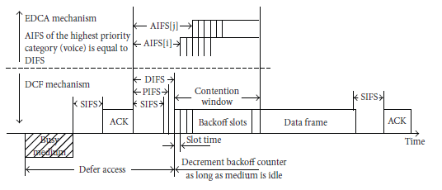
Different priority for different application category
Expand to more IFS lengths for different traffic categories
Smallest AIFS (equal to DIFS) goes to Voice, Largest to Background
Contention Window min and max also change for each category
Selects a probability that most important category goes first

Slide 125
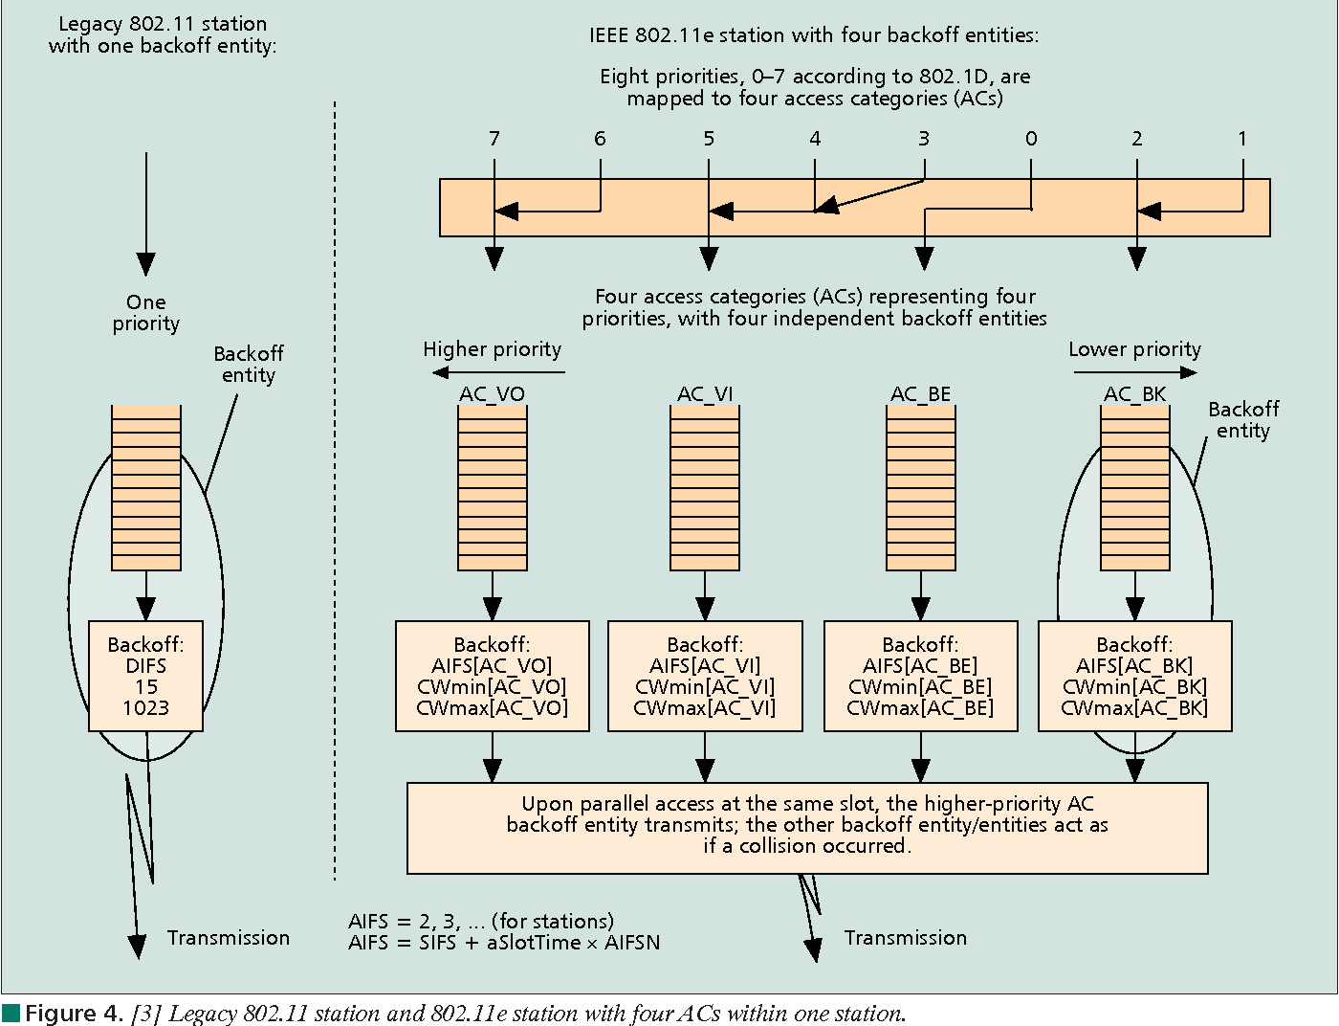
Multiple queues within a single device

Slide 126
802.11e also adds maximum durations
802.11e also defines duration a device can transmit for
Based on PHY in use and Application category
Background/Best Effort: one frame per contention win
Example, up to 11 ms for Voice on 802.11ac
Could be one really big frame at a low data rate
Could be multiple frames in a row separated by SIFS

Slide 127
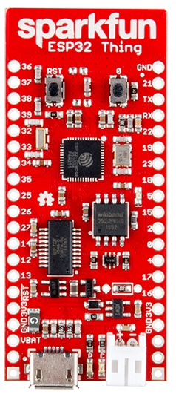
WiFi capability in microcontrollers
ESP32
Microcontroller plus WiFi radio in single chip
(Same idea as nRF52840)
Capabilities
802.11b/g/n 2.4 GHz only
20 MHz or 40 MHz channels
Single antenna only (no MIMO)
MCS0-7
7 Mbps – 150 Mbps
Tx power up to 20.5 dBm

Slide 128
Low power WiFi
Question: should a microcontroller stay connected or reconnect?
Light sleep: stay connected always, only listening to beacons
Deep sleep: reconnect to network each time data is ready
Answer for ESP32 depends on security and data interval
Resecuring during connection takes lots of energy
Crossover point is about 60 seconds
Insecure transmissions have a crossover of 5-15 seconds
https://blog.voneicken.com/2018/lp-wifi-esp-comparison/#conclusions

Slide 129
802.11ax (2021)
Standard approved on February 9th 2021
First devices started supporting it in 2019 (WiFi 6)
6 GHz band (WiFi 6E)
1.2 GHz of bandwidth (5.925-7.125 GHz)
2020: US FCC made band available for unlicensed use!!!
EU is expected to follow in March 2021
OFDMA
MAC scheduling variant of OFDM
Schedule devices based on time and subcarrier allocations

Slide 130
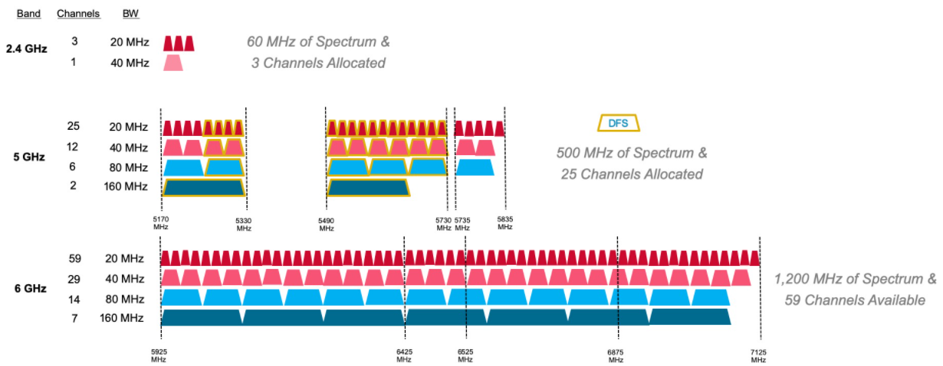
6 GHz band is an enormous amount of bandwidth

Slide 131
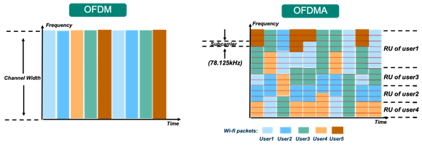
Orthogonal Frequency Division Multiple Access
OFDM: split channel into subcarriers and transmit on those
OFDMA: allocate subcarriers to a device for an amount of time
Turns OFDM into an access control mechanism
Complicated question: which device gets which subcarriers at which time?

Slide 132
Learning Objective for Today’s Lecture
Review: last few lecture’s topics
Basics of Medium Access Control
Classical/Historical Medium Access Control for IoT
Multi-channel MAC
IEEE 802.15.4
WiFi Mac

Slide 133
Wireless Networking
Ambuj Varshney
Assistant Professor, National University of Singapore
Wireless, Embedded Intelligence, Sensing, and Emerging Technologies Group
ambujv@nus.edu.sg

